Slide 1
Data Presentation
Marketing Analytics Project

Slide 2
Introduction to Business Problem
ShopEasy, an online retail business, is facing reduced customer engagement and conversion rates despite launching several new online marketing campaigns. They are reaching out to you to help conduct a detailed analysis and identify areas for improvement in their marketing strategies.
Key Points:
Reduced Customer Engagement: The number of customer interactions and engagement with the site and marketing content has declined.
Decreased Conversion Rates: Fewer site visitors are converting into paying customers.
High Marketing Expenses: Significant investments in marketing campaigns are not yielding expected returns.
Need for Customer Feedback Analysis: Understanding customer opinions about products and services is crucial for improving engagement and conversions.

Slide 3
Initial queries
A TOTAL OF 5 TABLES
Selected customers table (dimension), changed ‘age’ into brackets and created new column ‘age bracket’, joined with geography table for ‘location’, changed cities into 4 regions and created new column ‘region’
Selected products table(dimension), changed ‘product price’ into brackets(‘price_bracket’)
Selected customer reviews and replaced ‘double spaces’ to ‘single spaces’ in reviews.(fact table)
Selected engagement table and separated views and clicks columns, ContentType column is cleaned, Data format is adjusted, Filtered out ‘news letter’ from the “ContentType’ column as it is not required for our analysis
Selected customer journey table, upper(stage) is performed for consistency, used ‘rownumber’ to drop duplicates and select ‘avg duration’ column as per date and used ’coalesce’ to fill it up using subquery.

Slide 4
Python connect using pyodbc
Connect SQL database to Python using pyodbc and use nltk library to analyse the sentiment score
It provides score from -1 to 1 based on sentiment.
If >0.05 : its positive sentiment, if <0.05 : its negative sentiment,
Divide scores into buckets based on sentiment score and rating. And save it as csv file.

Slide 5
Power BI
Import data by connecting using sqlserver, add server and database name and import the tables.
Click on ‘ Transform data’ and change the data types of columns like floats and date formats.
Delete the ‘navigation’ and change the source sql query , so that some transformations will be done while importing.
Import csv file from python containing the sensitivity score.
Now create a data model in Power BI by establishing the correct relation ships.
Write a DAX script of calender and create a new table, which contain different data formats which will be useful for analysis later on and connect the date column to other fact tables in the data.

Slide 6
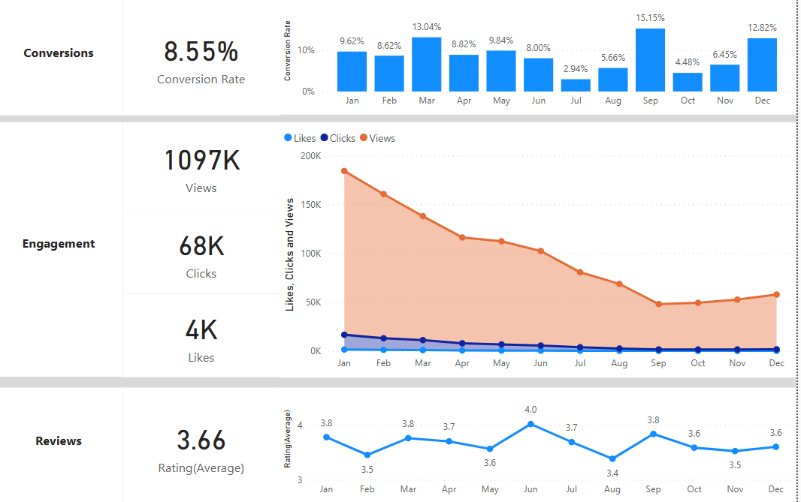
Overview
Decreased Conversion Rates:
In 2025, The conversion rate demonstrated a strong rebound in December, reaching 12.82%, despite a notable dip to 4.48% in October.
Reduced Customer Engagement:
There is a decline in overall social media engagement, with views and clicks dropping throughout the year.
The click-through rate is also consistently decreasing.
Customer Feedback Analysis:
Customer ratings have remained consistent, averaging around 3.66 throughout the year 2025, suggesting a need for focused improvements in customer satisfaction, for products with below average rating.

Slide 7
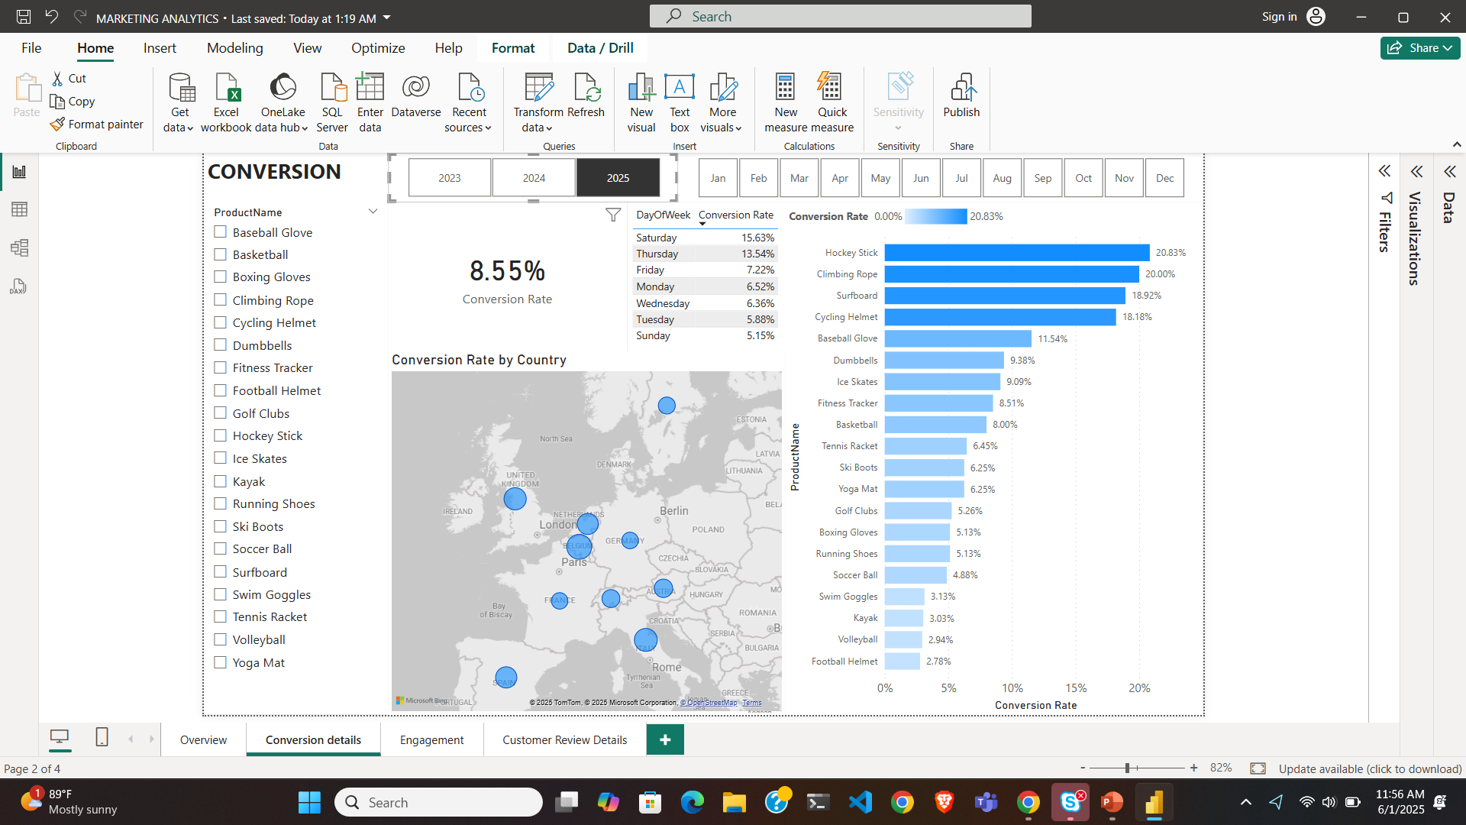
Decreased Conversion Rates
General Conversion Trend:
Throughout the year, the average conversion rate is 8.55, it is lesser than the expected 10%.
Lowest Conversion Day:
Sunday looks like the least conversion day of week in 2025, which is 3 times lesser than Saturday which is around 15.63%.
Lowest Conversion Rates by Country:
5.26% is conversion rate in France this year which is lowest. It used to be around 24% in 2023, which is a major drop
13.46% is the Belgium’s conversion rate, which is highest with respect to other regions.

Slide 8
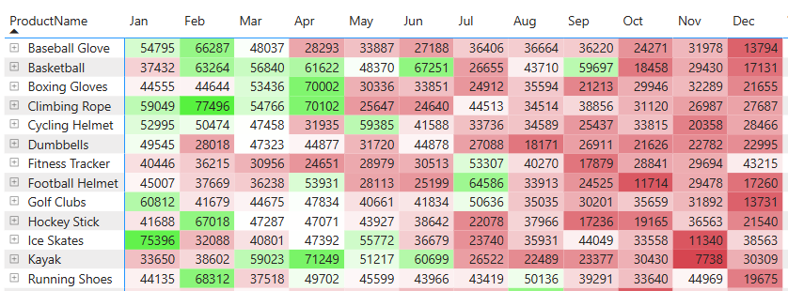
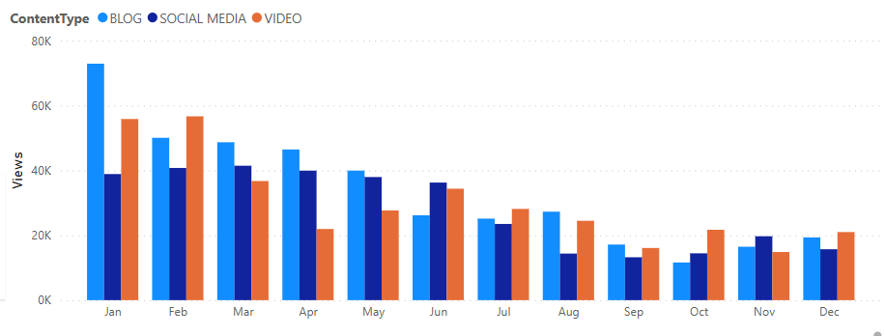
Reduced Customer Engagement
Strategy recommended:
Someone who viewed the cycling helmet in May and got a good number of views around 57000, the content related to Fitness Tracker can be also interesting to same viewers
Low Interaction Rates:
The serious problem is the views which are majorly decreasing. 5M views in 2023, 2.9 M views in 2024, but 1.1 M views in 2025
Clicks through rates are also decreasing heavily in 2025 monthly, suggesting the need for more engaging content or stronger calls to action.
Content Type Performance:
Blog content drove the most views, especially in January, while social media maintained consistent for first 6 months and drop then

Slide 9
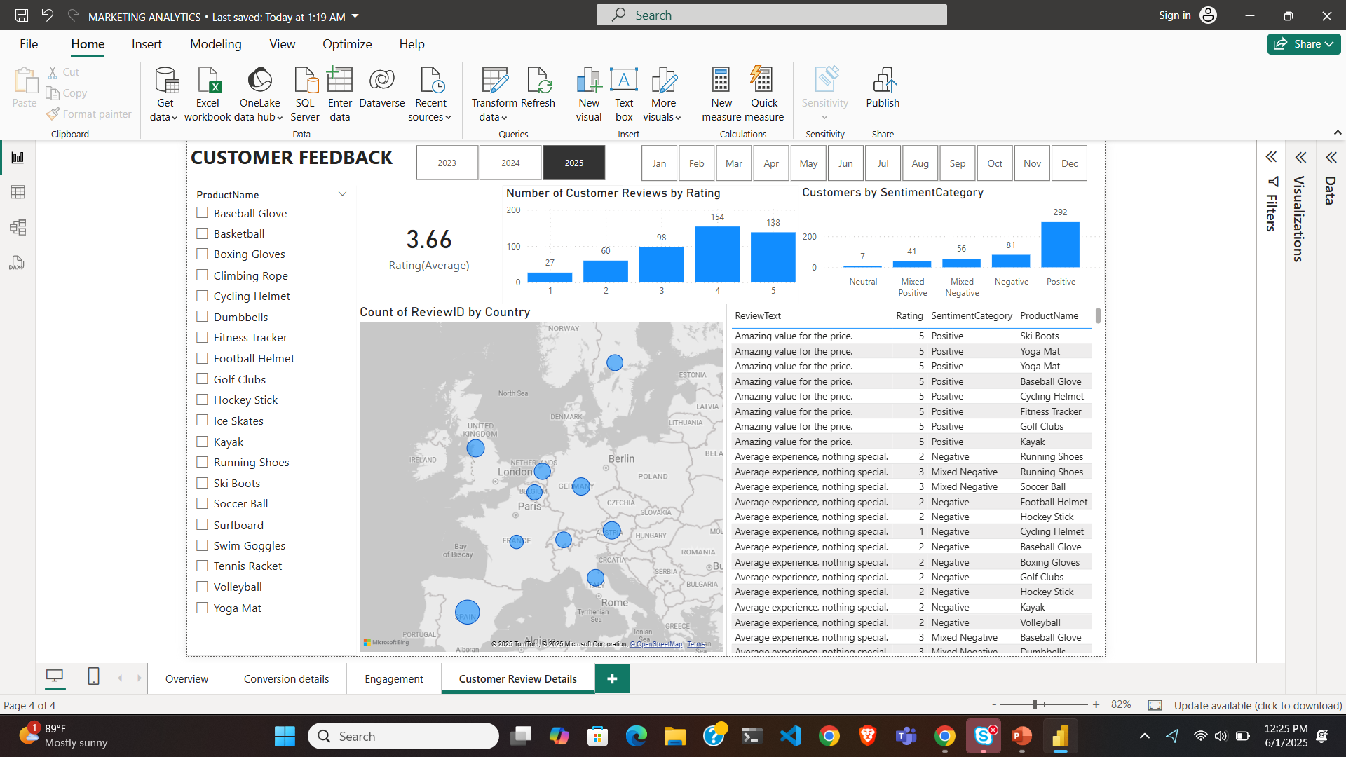
Customer Feedback Analysis
Customer Ratings Distribution:
The majority of customer reviews are in the higher ratings, with 138 reviews at 5 stars and 154 reviews at 4 stars, indicating overall positive feedback. Lower ratings (1-2 stars) account for a smaller proportion, with 27 reviews at 1 star and 60 reviews at 2 stars.
Sentiment Analysis:
Positive sentiment dominates with 292 reviews, reflecting a generally satisfied customer base. Negative sentiment is present in 81 reviews, with a smaller number of mixed and neutral sentiments, suggesting some areas for improvement but overall strong customer approval.
Opportunity for Improvement:
The presence of mixed positive and mixed negative sentiments suggests that there are opportunities to convert those mixed experiences into more clearly positive ones, potentially boosting overall ratings. Addressing the specific concerns in mixed reviews could elevate customer satisfaction.

Slide 10
Goals & Actions
Increase Conversion Rates:
Target High-Performing Product Categories: Focus marketing efforts on products with demonstrated high conversion rates, such as Hockey Stick, Ski Boots, and Baseball Gloves. Implement seasonal promotions or personalized campaigns during peak months (e.g., January) to capitalize on these trends.
Enhance Customer Engagement:
Revitalize Content Strategy: To turn around declining views and low interaction rates, experiment with more engaging content formats, such as interactive videos or user-generated content. Additionally, boost engagement by optimizing call-to-action placement in social media and blog content, particularly during historically lower-engagement months (September-December).
Improve Customer Feedback Scores:
Address Mixed and Negative Feedback: Implement a feedback loop where mixed and negative reviews are analyzed to identify common issues. Develop improvement plans to address these concerns. Consider following up with dissatisfied customers to resolve issues and encourage re-rating, aiming to move average ratings closer to the 4.0 target.
Increase Conversion Rates:
Goal: Identify factors impacting the conversion rate and provide recommendations to improve it.
Insight: Highlight key stages where visitors drop off and suggest improvements to optimize the conversion funnel.
Enhance Customer Engagement:
Goal: Determine which types of content drive the highest engagement.
Insight: Analyze interaction levels with different types of marketing content to inform better content strategies.
Improve Customer Feedback Scores:
Goal: Understand common themes in customer reviews and provide actionable insights.
Insight: Identify recurring positive and negative feedback to guide product and service improvements.

